Slide 1

Generating Hierarchical Explanations on Text Classification via Feature Interaction Detection
Hanjie Chen, Guangtao Zheng, Yangfeng Ji
19 October 2020
Presenter: Sanchit Sinha
https://qdata.github.io/deep2Read/

Slide 2
Motivation
Interpretability is important for reaffirming - reliability and trustworthiness of models
Overcoming “black-box” nature of deep learning models
Ideal goal of any interpretability technique - human understandable explanations
Hierarchical explanations - superior to simple attributions (proven by prior work)
Designing a model agnostic explainability approach - to works for any model - LSTM, BERT, etc.
Notes:
The motivation of this project

Slide 3
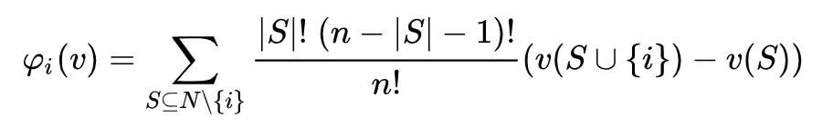
Background
Model agnostic Explainability:
Leave one out
LIME
Shapley Value based
Shapley Values:
Shapley value of a feature: contribution of that feature to the output
Hierarchical Explanations:
Proven to be most human friendly
ACD (discussed before) uses CD values as distance metric for bottom up clustering
Interactions between phrases important

Slide 4
Related Work
Shapley Interactions between features - Owen, 1972; Grabisch, 1997; Fujimoto et al., 2006
CD and ACD - Murdoch et al, Singh et al.
LIME
Consistent Individualized Feature Attribution for Tree Ensembles - Lundberg et al. (Shap values for trees)
BERT

Slide 5
Claim / Target Task
Designing a model agnostic explainability method
Detecting feature interaction: Use Shapley interaction values between two phrases as the “cut” metric - the lesser the value, the earlier the “cut”.
Quantifying feature importance: Assign importance values to each phrase at all levels
Improving metrics wrt current SOTA:
AOPC
Log Odds
Cohesion Score
Notes:
Here, we make the claim of this project.

Slide 6
Data Summary
All datasets are for Text classification
10% held out for dev set
SST-2: Binary Labels - 6920/872/1821 examples in the train/dev/test set
IMDb : Binary Labels - 25000/25000 examples in the train/test set

Slide 7
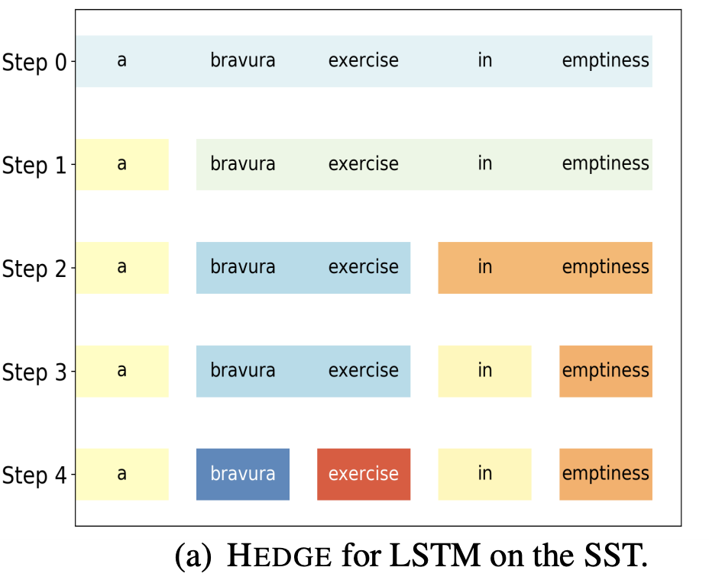
An Intuitive Figure Showing WHY Claim
Notes:
Here, we make the claim of this project.

Slide 8
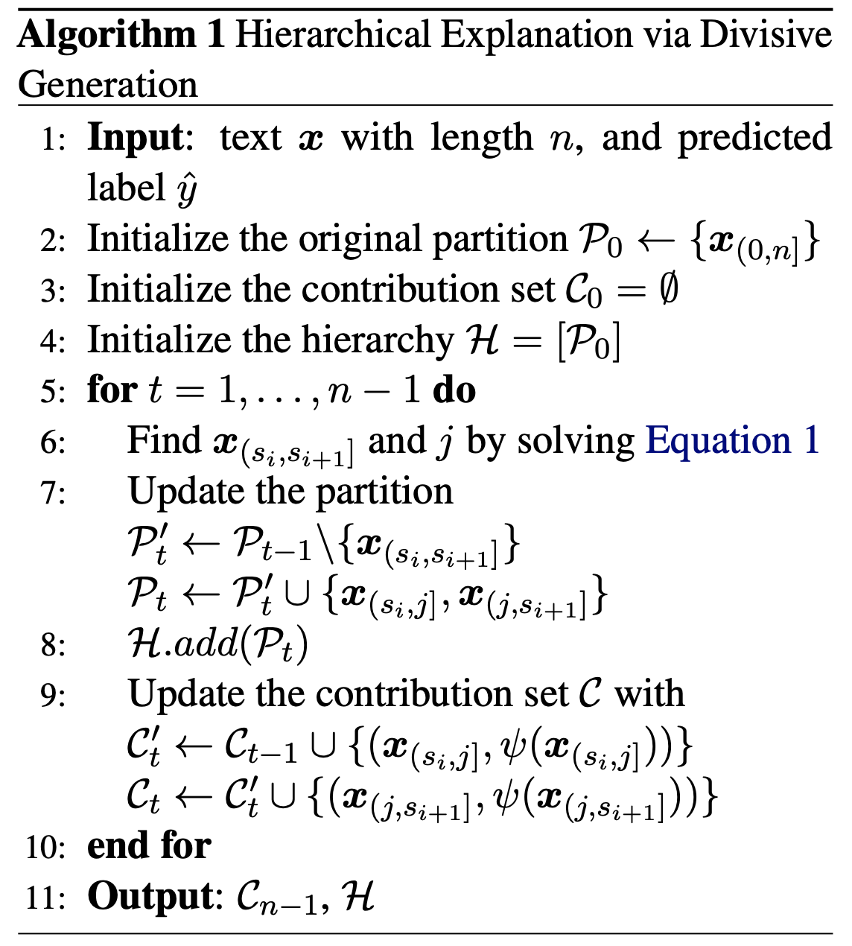
Proposed Solution
The intuition of the algorithm can be divided into two parts.
Part 1: Finding the “split point” where we divide a phrase into 2 least interacting phrases
Part2: Quantifying the impact of a phrase on the prediction
Levels = words-1
Creating partition
Value, Structure
Notes:
Here is our proposed solution.

Slide 9
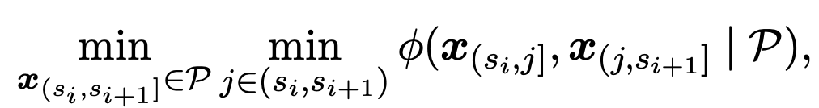
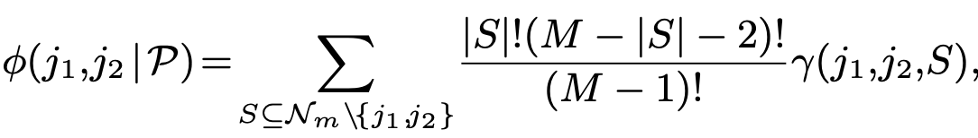
Proposed Solution
Part 1: Finding the split -
Step 0: The whole sentence is a partition.
Step 1: For every phrase pair, calculate the following:
Creating phrase: {word 0, word 1,n} {word 0,1, word 2,n}
Selecting the split point where the phi function value is the least
Phi value is basically the Shapley value for interaction between 2 phrases
Calculating the phi function value:
Is the same as the Shapley value. Here M-1 is the size of partition after removing 2 interacting phrases
Notes:
Here is our proposed solution.

Slide 10
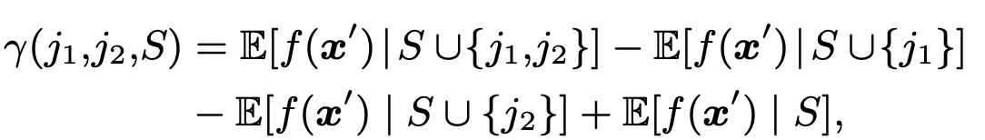
Proposed Solution
Original Shapley:
Modified Shapley interaction
The size of neighbourhood (M) is set to a smaller value due to words having highest interaction with words before or after the most rather than far away.
This means that complexity for each word is fixed at +/- 2 which is polynomial, but if the whole sentence is taken the complexity multiplies by ‘n’ (size of sentence)
Notes:
Here is our proposed solution.

Slide 11
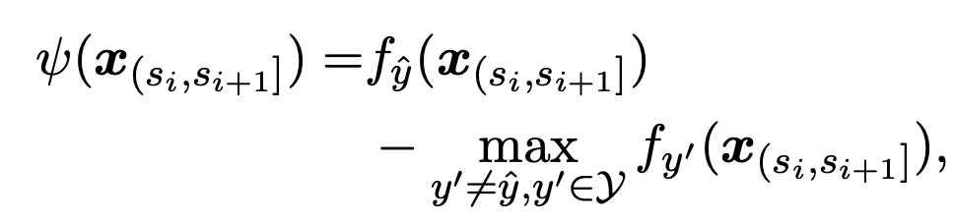
Proposed Solution
Part 2 - Quantifying feature importance
Basically how far away from the decision boundary is our prediction
The farther away, the more important the feature to the prediction value
This makes the algorithm model agnostic

Slide 12
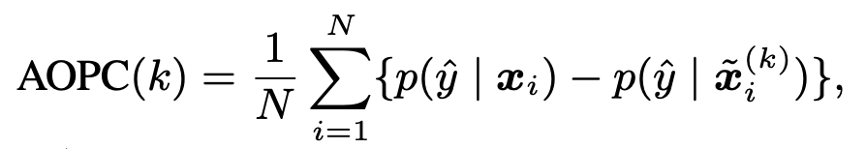
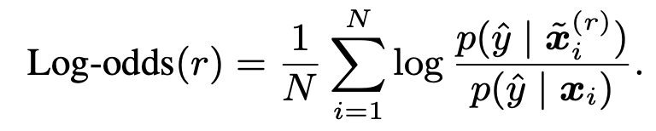
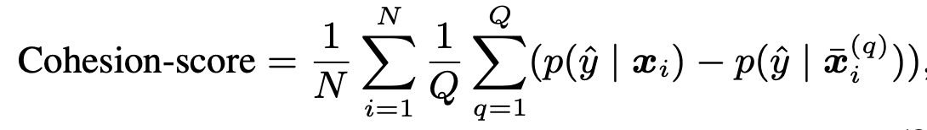
Experimental Results - Metrics
AOPC - “average change in the prediction probability on the predicted class over all test data” - Remove top k% words and then measure the drop in performance. Higher is better
Log Odds - “averaging the difference of negative logarithmic probabilities on the predicted class over all of the test data before and after masking the top r% features with zero paddings” - occlusion. Lower is better
Cohesion Score - Permuting each word of the sentence and calculate interactions. Higher is better.
Notes:
In the rest of this presentation, I’m going to talk about following contents:

Slide 13
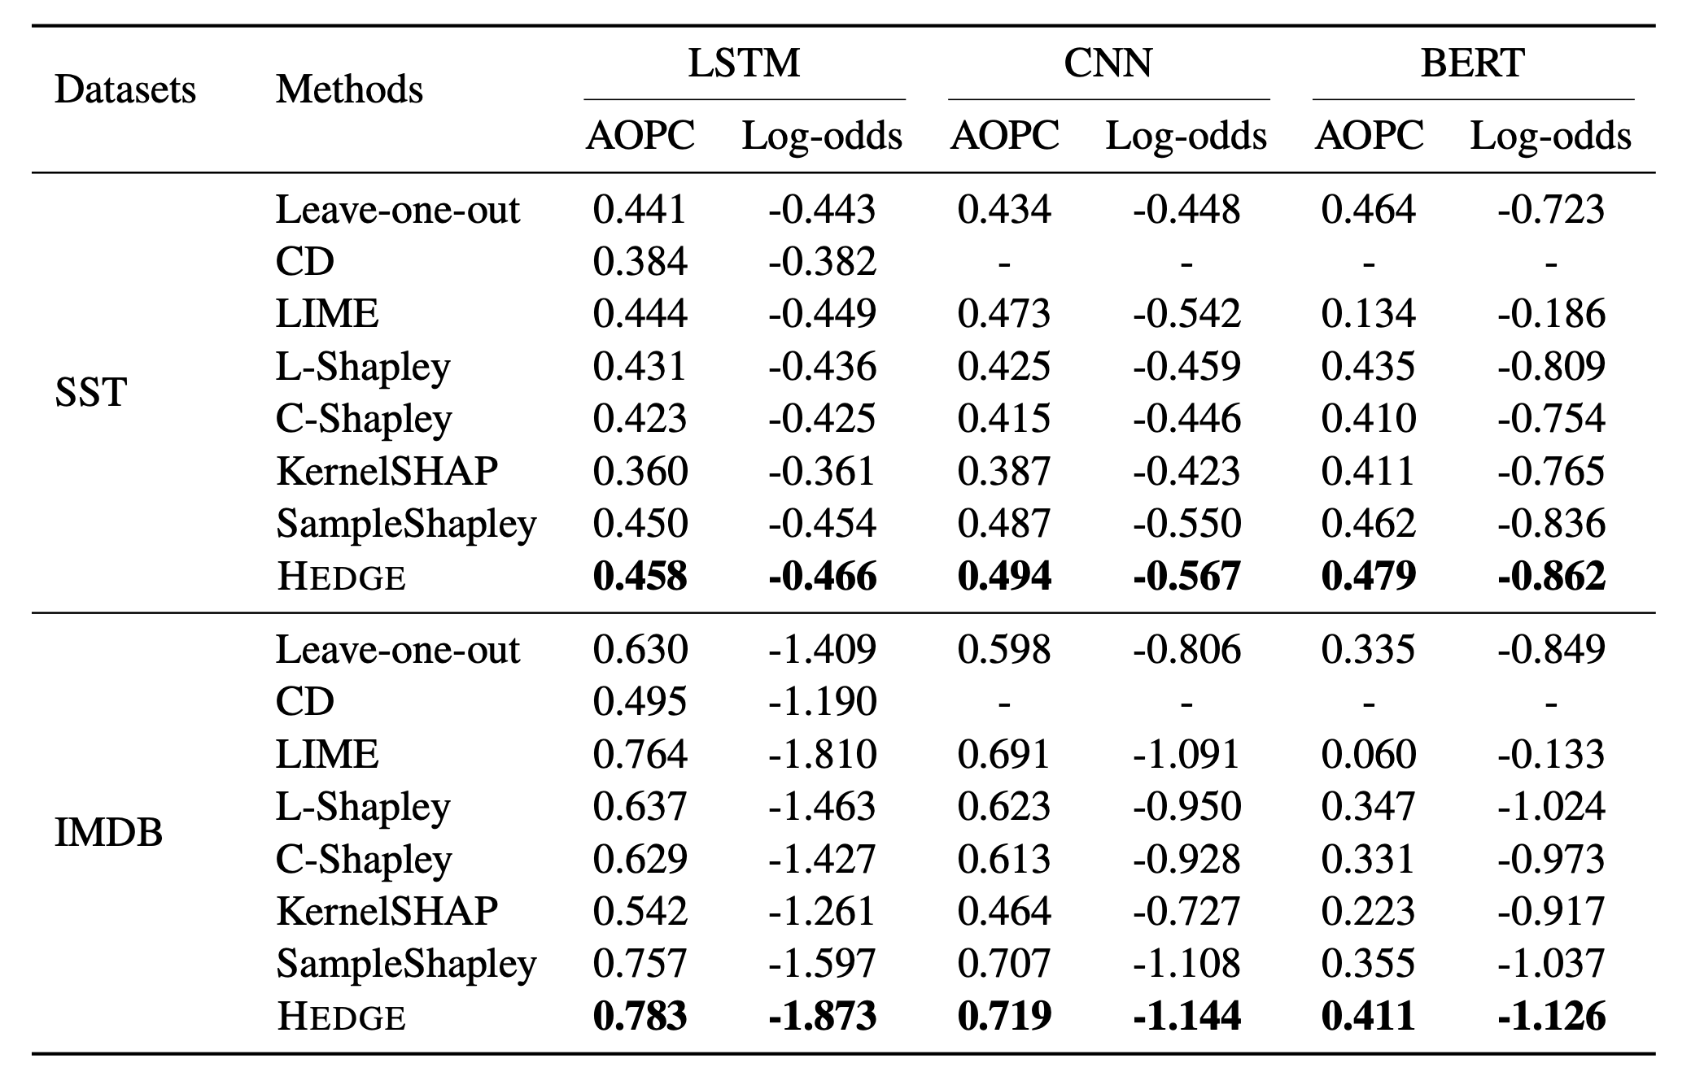
Experimental Results - AOPC/Log Odds
Notes:
In the rest of this presentation, I’m going to talk about following contents:

Slide 14
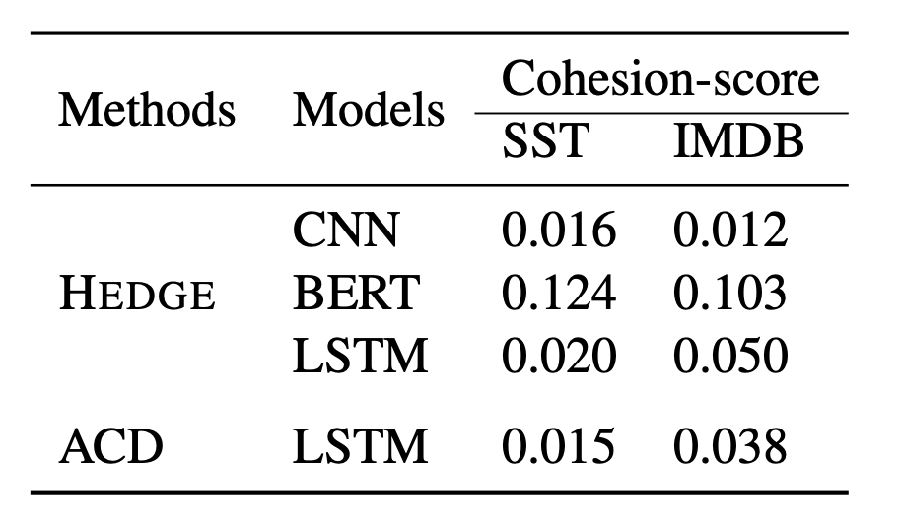
Experimental Results - Cohesion
Notes:
In the rest of this presentation, I’m going to talk about following contents:

Slide 15
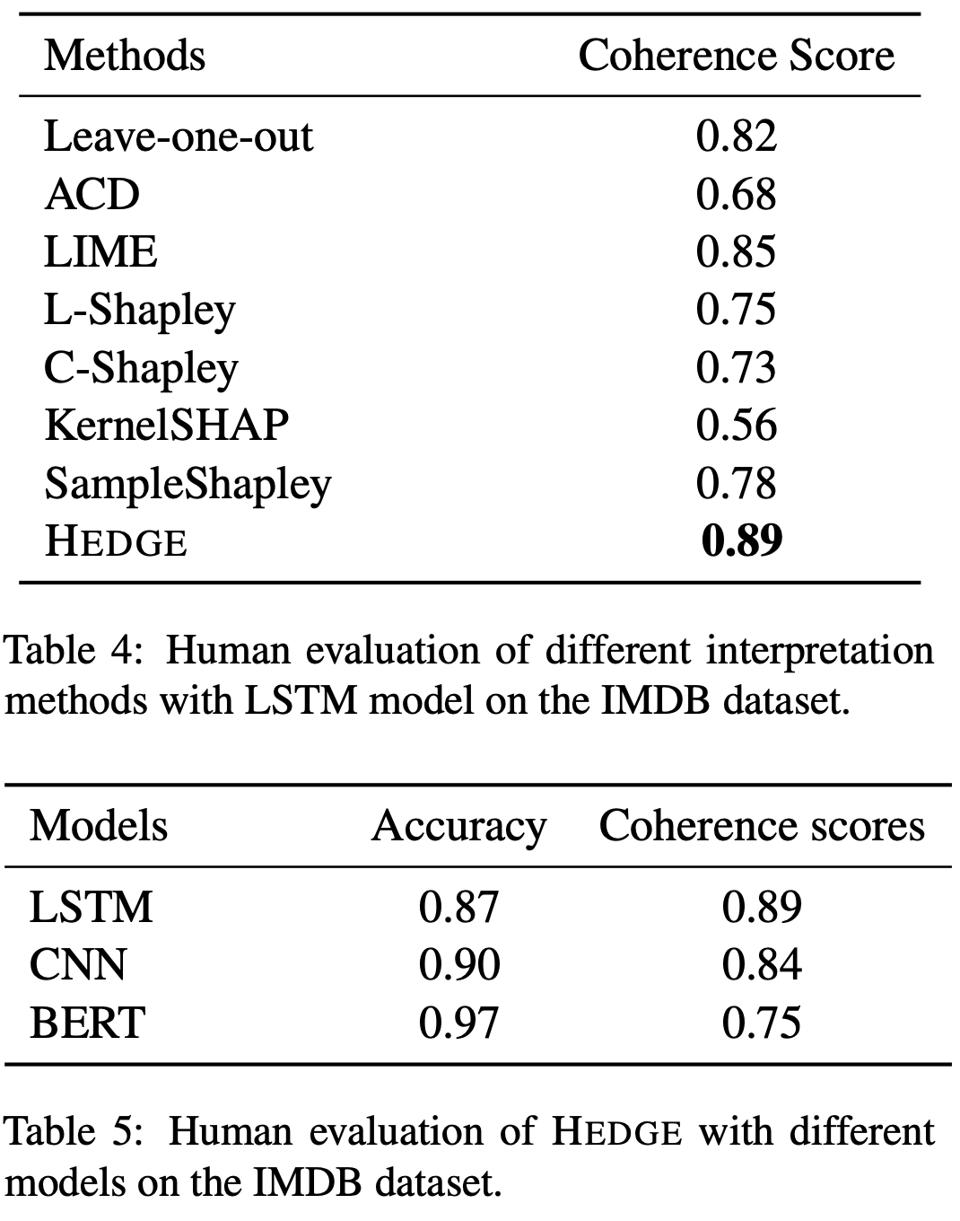
Experimental Results - Coherence/AMT

Slide 16
Experimental Analysis
Explanation method works well
Works better than LIME, ACD, Shapley
BERT gives very high accuracy but is not very interpretable
Notes:
In the rest of this presentation, I’m going to talk about following contents:

